Slide 1


Final Project Evaluation Subject code: PROJ-CS781
1
Department of Computer Science & Engineering

Slide 2
Group No.: 06 Team Members:
NAME | UNIVERSITY ROLL NO.
Somashree Barman | 11500120076
Shreya Das | 11500120090
Somdeep Sardar | 11500120091
Srijita Majumder | 11500121105

Slide 3
Sports Management System

Slide 4
CONTENTS
Objectives
Background
Proposed System
System Requirements
Design
Future Plan
Conclusion

Slide 5
Objectives
The objective of Sports Management System is to provide a system which manages the activity of many sports at a time.
The users will consume less amount of time when compared to manual paper work through the automated system.
The system will take care of all the servicing activity in a quick manner.
Data storing is easier. It will be able to check any report at any time.
The admin can manage the game, manage team and manage player, team members. Admin can even schedule the events and news for the tournament.
Students can view the tournament details and upcoming match.
This system aims to centralize administrative tasks, enhance communication, and facilitate efficient resource allocation.

Slide 6
BACKGROUND
Traditional sports management systems often suffered from a range of limitations that hampered their effectiveness. These systems relied heavily on manual processes, inundating administrators with paperwork and increasing the likelihood of errors.
Information was often disorganized, scattered across various platforms or stored in physical documents, leading to inefficiencies in data management and retrieval.
Moreover, the absence of data analytics made it challenging to derive insights for informed decision-making and optimizing performance.
In terms of fan engagement, these systems lacked the necessary tools to effectively engage audiences, impacting the overall support and interaction with teams and events.
Overall, the traditional sports management systems were constrained by their reliance on manual processes and limited technological capabilities, inhibiting efficiency and growth within sports organizations.
Sports Management Systems are software applications that streamline sports organization operations. They handle player/team management, event scheduling, finances, fan engagement, analytics, and communication. These systems leverage technology to enhance efficiency, engagement, and overall success in sports management.

Slide 7
PROPOSED SYSTEM
Key Features:
User Authentication and Authorization | ● Secure login for different user roles (players, coaches, administrators). ● Role-based access control to ensure appropriate permissions.
Event Management | ● Dynamic event scheduling with real-time updates. ● Registration and enrollment for players and teams. ● Automated event reminders and notifications.
Chatbot Integration | ● AI-driven chatbot for natural language interaction. ● Event information, registration assistance, and general queries. ● Continuous learning and improvement through user interactions.
User Dashboard | ● Personalized dashboards for users with relevant information. ● Display of upcoming events, team performance, and personalized recommendations.
Team and Player Information | ● Comprehensive profiles for teams and players. ● Real-time statistics and performance analytics. ● Historical data for analysis and strategic planning.
Administrative Tools | ● Admin dashboard for centralized management. ● User account management and authorization. ● Event creation, modification, and reporting tool
Notifications and Alerts | ● Automated notifications for event updates, scores, and announcements. ● Customizable notification preferences for users.

Slide 8
System Architecture:
Frontend | ● Intuitive web-based interface for users. ● Responsive design for seamless accessibility on various devices.
Backend | ● Robust database for efficient data storage and retrieval. ● Integration with third-party APIs for additional functionalities. ● Cloud-based infrastructure for scalability and reliability.
Chatbot Module | ● Integration of natural language processing (NLP) for effective communication. ● Continuous learning and improvement through user interactions. ● Integration with backend systems for real-time data retrieval. ● Chatbot: Python, DialogFlow for NLP

Slide 9
SYSTEM REQUIREMENTS
❖ Hardware Requirements:
• Processor: Intel dual core
• Processor Speed: 1.0 GHz or above
• RAM: 1GB or above
• Hard Disk: 20GB or above
❖ Software Requirements:
• Operating System: Windows 8 or above
• User Interface: HTML, CSS, Javascript
• Backend: PHP
• Database: MYSQL

Slide 10
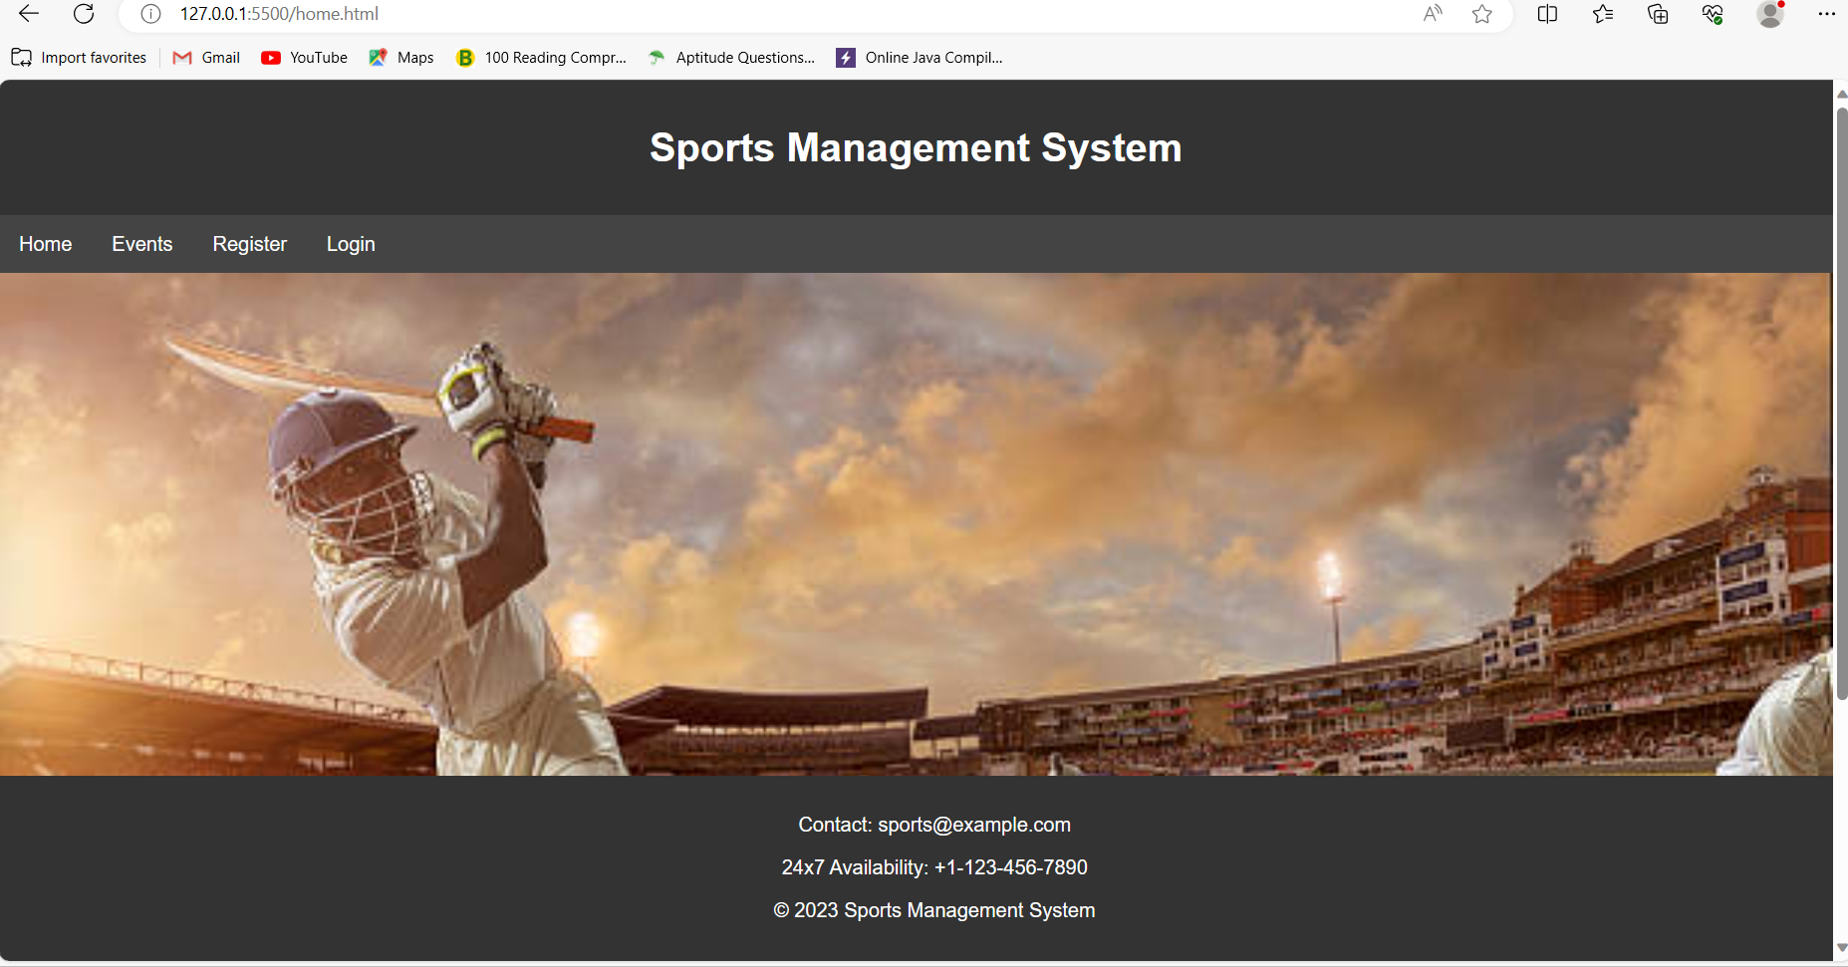
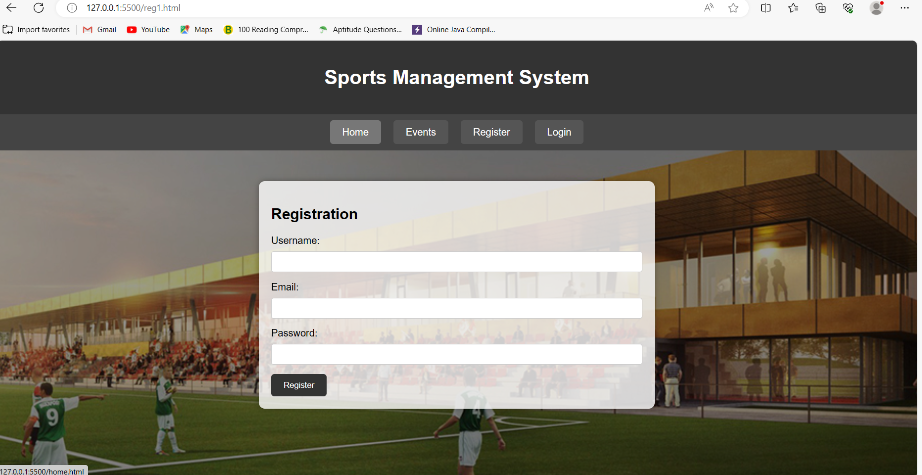
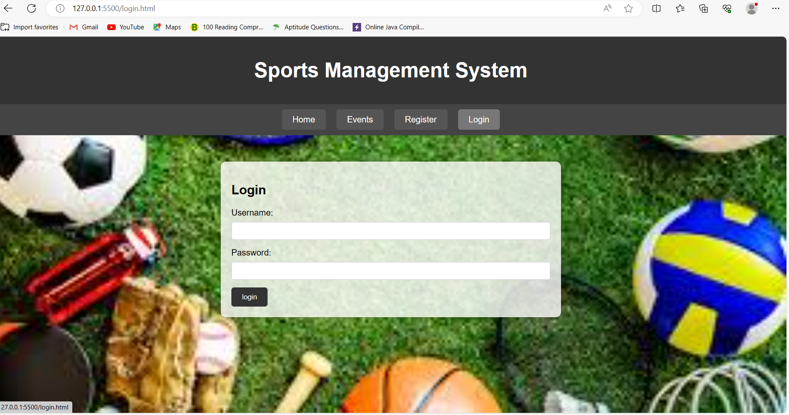
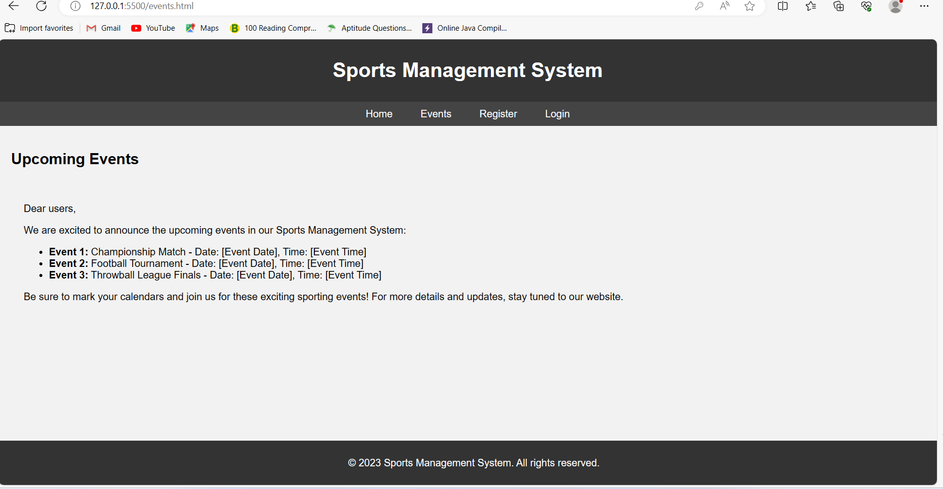
DESIGN

Slide 11
FUTURE PLAN
We will integrate chatbot in our website. Implementing a chatbot in a sports management system website involves integrating various technologies.
LangChain would be used to process and understand user queries or commands in natural language. It might include functionalities for language understanding, intent recognition, and entity extraction.
The SQL database would store data related to the sports management system, such as user accounts, team details, match schedules, and player information. The chatbot might interact with the database to retrieve or update information based on user queries.
Dialog Flow (AI chatbot framework with machine learning capabilities, NLP, and integration with popular communication platforms) would be used to define the conversational flow and natural language understanding capabilities of the chatbot. You would create intents in Dialog Flow to capture the various actions or queries that users might make regarding sports management.
The integration involves a collaborative effort between LangChain for natural language processing, Dialog Flow for conversation design and understanding, and an SQL database for storing and retrieving data related to the sports management system. The goal is to create a seamless and intuitive chat-based interface for users to interact with the sports management system.

Slide 12
CONCLUSION
The adoption of modern sports management systems represents a pivotal shift in optimizing sports organizations. These systems offer streamlined operations, centralized data management, enhanced communication, and crucial analytical insights. By leveraging technology, they empower administrators to make data-driven decisions, improve efficiency in managing teams and events, engage fans more effectively, and ensure better financial control. The transition from traditional methods to these sophisticated systems marks a transformative step, revolutionizing how sports entities operate, compete, and engage with their stakeholders in today's dynamic sports landscape.

Slide 13
REFERENCES
http://ijariie.com/AdminUploadPdf/SPORT-EVENT-MANAGEMENT-PLATFORM-FOR-COLLEGE-ijariie13718.pdf
https://www.slideshare.net/DilipPrajapati4/sport-tournament-management-system
https://nevonprojects.com/sports-eventmanagementcollegesproject/
https://www.irjmets.com/uploadedfiles/paper/volume2/issue-7-july-2020/2480/1628 083092.pdf
https://www.ijresm.com/Vol.3-2020/Vol3-ss6June20/IJRESM-V3-I6-182.pdf

Slide 14
THANK YOU!!!

